Slide 1
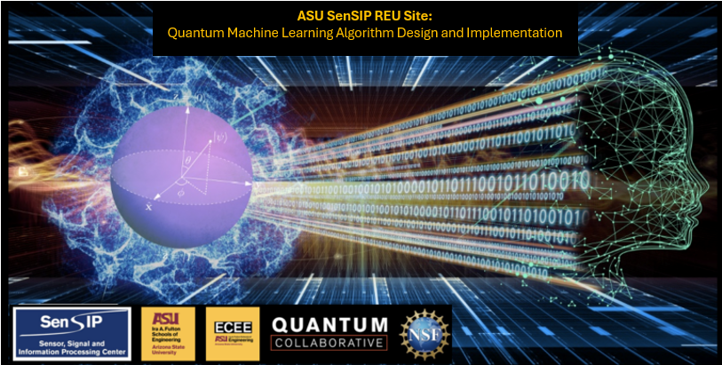

Sunil Vittal
Quantum Generative Neural Networks For Imaging Applications
Princeton University
Mentors: David Ramirez, Glen Uehara, Gennaro De Luca, Andreas Spanias
NSF Award 2349567

Slide 2
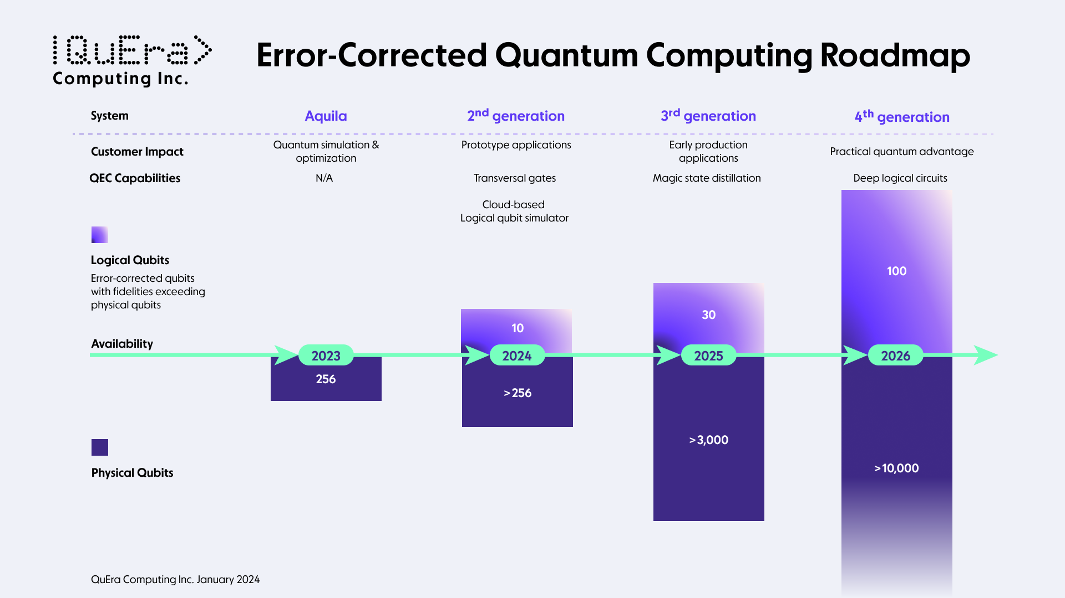
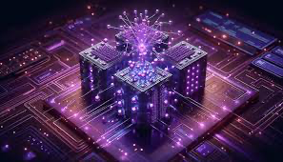
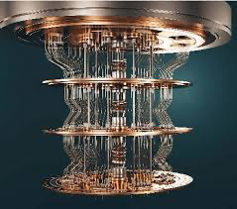
Research Background
Quantum Machine Learning (QML) contributes to a theoretical training speed-up of large scale models, but we are currently in the Noisy Intermediate Scale Quantum (NISQ) era. [1, 2]
Can only use few qubits due to noisy small-scale computers.
Motivates the construction of larger, more fault-tolerant quantum computers.
Why Image Generation?
Gives a users free expression with short prompts, allows automations of tasks, etc.
How can we utilize QML for image generation?
Extremely large classical generative models can take days to train [3]
QML advantage + fault tolerance -> faster training for large models in a resource efficient manner.

Slide 3
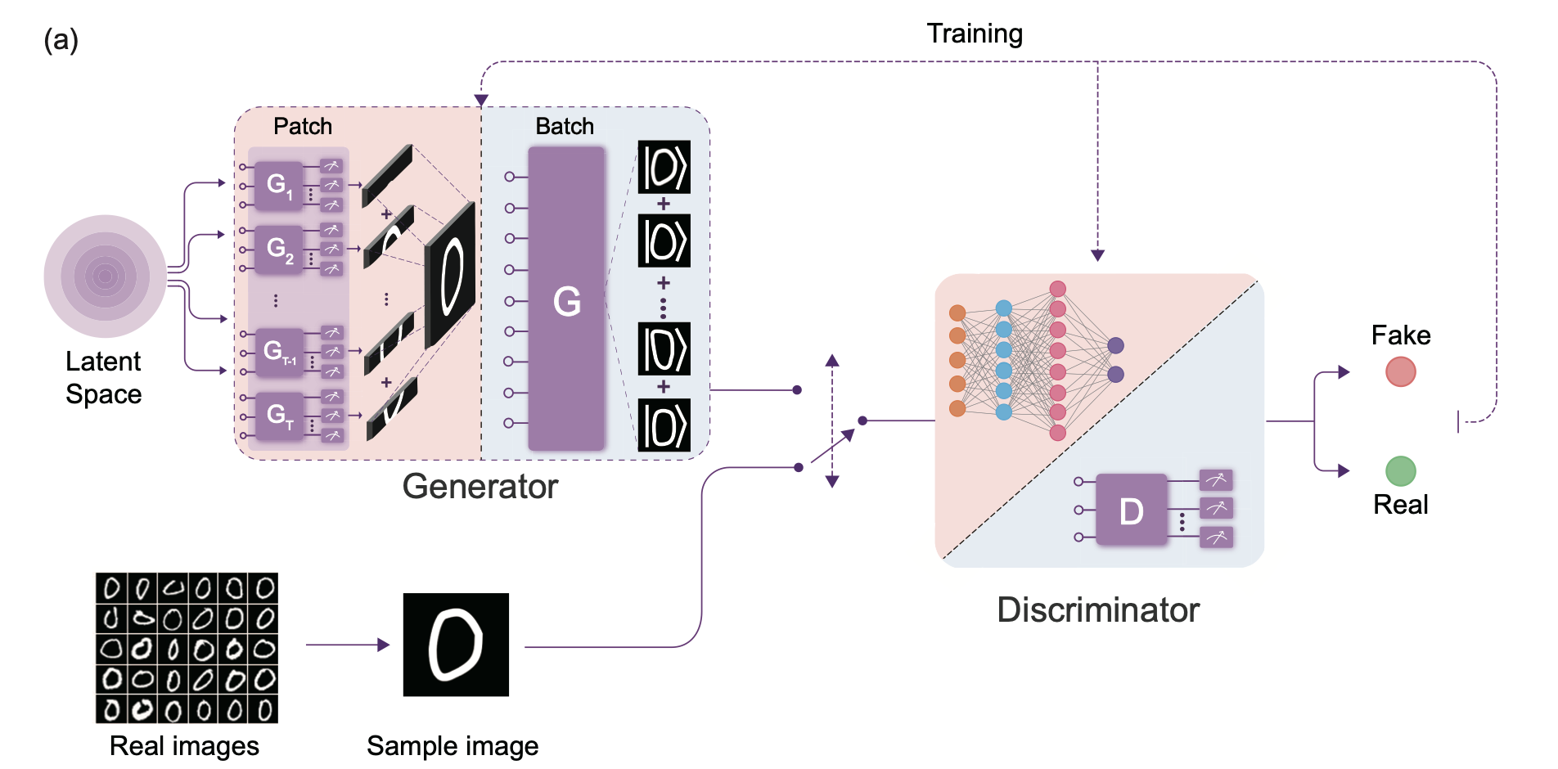
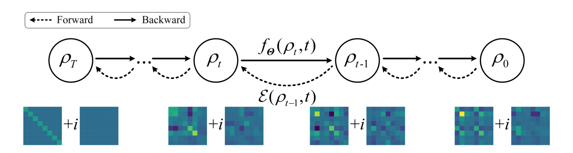
Research Background
Current Theoretical Models:
Quantum Generative Adversarial Network (QGAN) [4]
Quantum Autoencoder [5]
Quantum Denoising Diffusion Models (QDDPM) [6]
Past Results:
Small Scale Image Generation with the MNIST [7] and Fashion MNIST [8] datasets
Patch QGAN [9] and QDDPM [6]

Slide 4
Research Objectives
Classical simulation of quantum computation is slow -> How can we utilize concepts from quantum mechanics to speed this up?
What is the level of complexity that a fully quantum generative neural network can handle?
How much help classically does such a quantum generative model need?
What are the quantitatively observable advantages of a quantum-classical hybrid approach?

Slide 5
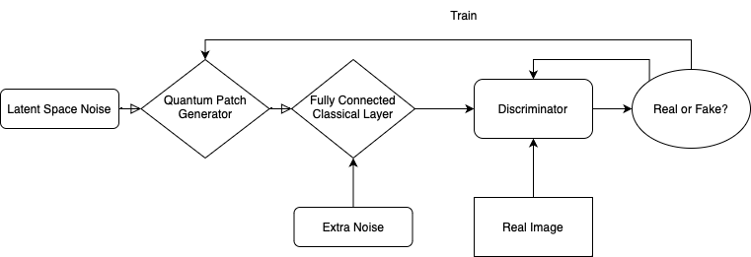
Model Architecture
Quantum-Classical Hybrid Patch Generator [8] + Fully Connected Discriminator
Quantum portion has 3 circuits and R generators, where R is the number of rows in the target image
Train the Discriminator every other image on 32 x 32 MNIST Images

Slide 6
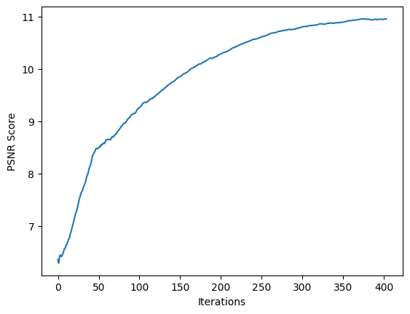
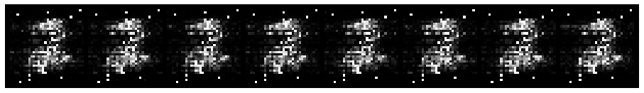
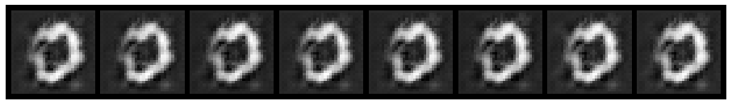
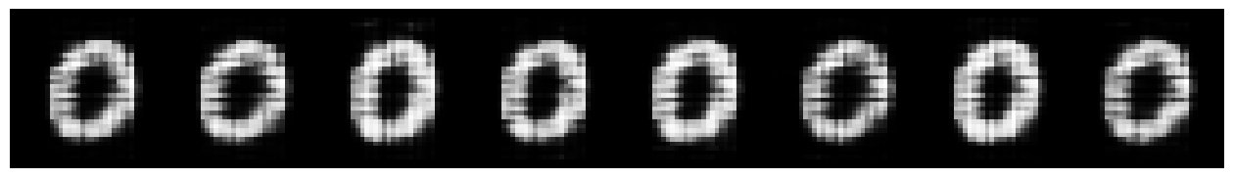
Research Results
Purely Quantum Models:
Have random bright pixels since it is hard to zero out values
Encounter Mode-Collapse as images get larger
Hybrid Model with Minimal Classical Component:
Allows us to correct mode collapse and acquire better images
Has a fraction of the weights of a classical GAN
The Hybrid model achieves a comprehensible image with fewer iterations than a
classical model
Fully Quantum Generator (after 300 images)
Classical GAN (after 300 images)
Hybrid Generator
(after 300 images)

Slide 7
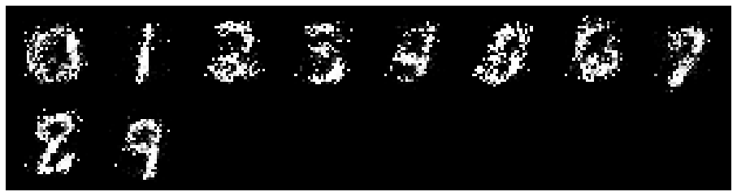
Concluding Remarks
Future Work
Class Conditional qGAN
Constructing a model with quantum advantage on color images
What did I learn?
Machine Learning! (Both Classical and Quantum)
Nice to apply my quantum computing knowledge to a budding field
Preliminary training results for a Class Conditional GAN after 2 Epochs

Slide 8
Acknowledgements
Thank you to David and Glen, my graduate student mentors, and Prof De Luca and Prof. Spanias for giving feedback, ideas, and educational resources for my project.

Slide 9
References
[1] G. De Luca, "A Survey of NISQ Era Hybrid Quantum-Classical Machine Learning Research," Journal of Artificial Intelligence and Technology. vol. 2. no. 1, pp. 9–15. 2021.
[2] Cerezo M, Verdon G, Huang H Y, et al, “Challenges and opportunities in quantum machine learning,” Nature Computational Science, vol 2, pp. 567-576, 2022.
[3] A. Brock, J. Donahue, and K. Simonyan, "Large Scale GAN Training for High Fidelity Natural Image Synthesis," arXiv:1809.11096 [cs.LG], Sep. 2018. [Online]. Available: https://arxiv.org/abs/1809.11096
[4] P.-L. Dallaire-Demers and N. Killoran, "Quantum generative adversarial networks," arXiv:1804.08641 [quant-ph], Apr. 2018. [Online]. Available: https://arxiv.org/pdfabs/1804.0864
[5] J. Romero, J. P. Olson, and A. Aspuru-Guzik, "Quantum Autoencoders for Efficient Compression of Quantum Data," arXiv:1612.02806 [quant-ph], Dec. 2016. [Online]. Available: https://arxiv.org/abs/1612.02806
[6] B. Zhang, P. Xu, X. Chen, and Q. Zhuang, "Generative Quantum Machine Learning via Denoising Diffusion Probabilistic Models," Phys. Rev. Lett., vol. 132, no. 10, p. 100602, Mar. 2024, doi: 10.1103/PhysRevLett.132.100602.
[7] L. Deng, "The MNIST Database of Handwritten Digit Images for Machine Learning Research [Best of the Web]," IEEE Signal Processing Magazine, vol. 29, no. 6, pp. 141-142, Nov. 2012, doi: 10.1109/MSP.2012.2211477.
[8] H. Xiao, K. Rasul, and R. Vollgraf, “Fashion-MNIST: a Novel Image Dataset for Benchmarking Machine Learning Algorithms.” 2017.
[9] H.-L. Huang, Y. Du, M. Gong, Y. Zhao, et. al, "Experimental Quantum Generative Adversarial Networks for Image Generation," arXiv:2010.06201 [quant-ph], Oct. 2020. [Online]. Available: https://arxiv.org/pdf/2010.06201

